Slide 1

SUBMITTED BY: Name: Archit Thakur Roll No: 1611981081 Branch: Comp. Engineering Section : 6th(UX Design) Semester
UX Design &
Digitalization
Submitted To:
Mr. Subhash.

Slide 2


Slide 3
PROBLEM WE HAVE
These days our Education System is blamed the most because increase in the unemployment.
But the Education System alone is not only responsible for this we the student play equal role.
We are not doing what we are supposed to do. We should start learning things by own for better
Understanding and better Results. We are dependent on our Professors or Teachers.
The Main Problems Are:-
1.How to learn the course?
2.From where to learn?
3.How much time we have to devote?

Slide 4
COURSES IN CSE B.tech
Data Structures
Programming with Java
UI/UX Design
Computer Networks
Web Technology
Computer Graphics
Linux OS
Digital System Design
Advanced DBMS
Microprocessors
Computer Organization
Cyber Law and IPR
Database Management
Operating Systems
Application Security

Slide 5
SURVEY
TELEPHONIC SURVEY
ONLINE SURVEY
FIELD SURVEY

Slide 6
TELEPHONIC SURVEY
Person-1 Name : Yashveer Singh Thakur , Age : 22 , Stream : CSE , University : Chitkara-University , Baddi.
Q : Do you had any guidelines about this course ?
A : No, I just heard that there is very much scoop in this course.
Q : Do you want to go for Masters after your Bachelor Degree ?
A : NO.
Q : Do you think study more than 20-30 subjects in four years worthiness ?
A : Obviously NO, Just wastage of time and money.
Q : You recommend this course for your siblings ?
A : YES, because we get to learn different courses in four years and if we do mastery in one we get good job.
Q : Did you get placed after the course completion?
A : Yes, I was placed in good IT company.

Slide 7
TELEPHONIC SURVEY
Person-2 Name : Kusum Thakur, Age : 23 , Stream : CSE , University : Chandigarh University.
Q : Do you had any guidelines about this course ?
A : Yes, My elder brother is also CSE Engineer from NIT Hamirpur.
Q : Do you want to go for Masters after your Bachelor Degree ?
A : NO.
Q : Do you think study more than 20-30 subjects in four years worthiness ?
A : No, According to me it’s just put lot of pressure on student.
Q : You recommend this course for your siblings ?
A : NO.
Q : Did you get placed after the course completion?
A : No, I was not placed.

Slide 8
TELEPHONIC SURVEY
Person-3 Name : Shavi , Age : 24 , Stream : CSE , University : NIT Hamirpur.
Q : Do you had any guidelines about this course ?
A : NO, But i learned about this course from internet.
Q : Do you want to go for Masters after your Bachelor Degree ?
A : NO.
Q : Do you think study more than 20-30 subjects in four years worthiness ?
A : No, According to me it is not worthiness.
Q : You recommend this course for your siblings ?
A : Yes, This course provide great exposer to the student.
Q : Did you get placed after the course completion?
A : Yes, I was placed in Reliance company.

Slide 9
TELEPHONIC SURVEY
Person-4 Name : Shivani, Age : 22 , Stream : CSE , University : IIT Mandi.
Q : Do you had any guidelines about this course ?
A : Yes.
Q : Do you want to go for Masters after your Bachelor Degree ?
A : Yes, I want to go for Masters.
Q : Do you think study more than 20-30 subjects in four years worthiness ?
A : No, According to me it is not worthiness.
Q : You recommend this course for your siblings ?
A : Yes.
Q : Did you get placed after the course completion?
A : Yes.

Slide 10
Conclusion.

Slide 11
ONLINE SURVEY
Person-1 Name : Akash Yadav, Age : 21 , Stream : CSE , University : Chitkara University.
Q : From where you want to learn ?
A : Personal Trainer.
Q : How long you want to study course ?
A : Three Month.
Q : Timing for the course ?
A : College Timing.
Q : Do you want to go for masters in your course ?
A : Yes.

Slide 12
ONLINE SURVEY
Person-2 Name : Chandan , Age : 22 , Stream : CSE , University : Chitkara University.
Q : From where you want to learn ?
A : Online Course.
Q : How long you want to study course ?
A : Six Month.
Q : Timing for the course ?
A : College Timing.
Q : Do you want to go for masters in your course ?
A : No.

Slide 13
ONLINE SURVEY
Person-3 Name : Aditya, Age : 21 , Stream : CSE , University : Chitkara University.
Q : From where you want to learn ?
A :Regular Classes.
Q : How long you want to study course ?
A : One Year.
Q : Timing for the course ?
A : Extra Hours.
Q : Do you want to go for masters in your course ?
A : No.

Slide 14
ONLINE SURVEY
Person-4 Name : Avantika, Age : 21 , Stream : CSE , University : Chitkara University.
Q : From where you want to learn ?
A :Regular Classes.
Q : How long you want to study course ?
A : One Year.
Q : Timing for the course ?
A : College Timing.
Q : Do you want to go for masters in your course ?
A : Yes

Slide 15
ONLINE SURVEY
Person-5 Name : Rahul, Age : 22 , Stream : CSE , University : Chitkara University.
Q : From where you want to learn ?
A :Regular Classes.
Q : How long you want to study course ?
A : Six Months.
Q : Timing for the course ?
A : Extra Hours.
Q : Do you want to go for masters in your course ?
A : No.

Slide 16
CONCLUSION
Extra Hours.
No.
One Year.
College Timing.
Yes.
Three Month.

Slide 17
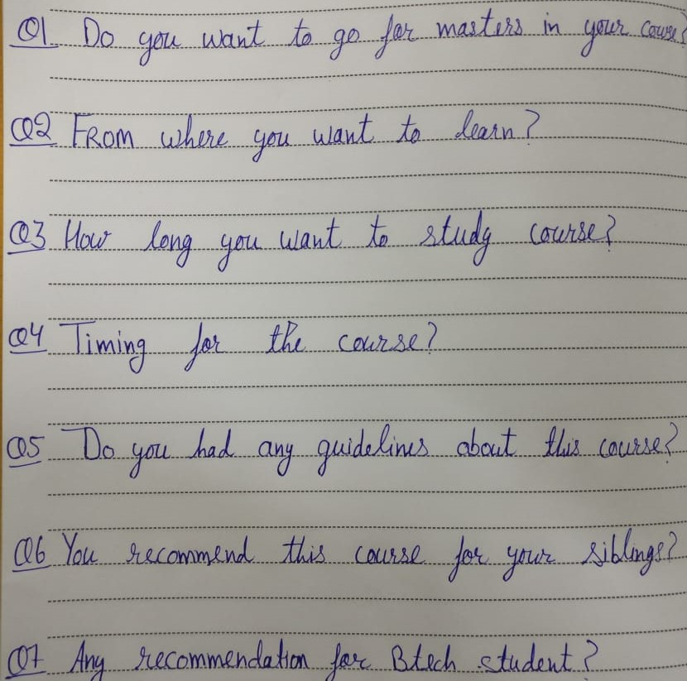
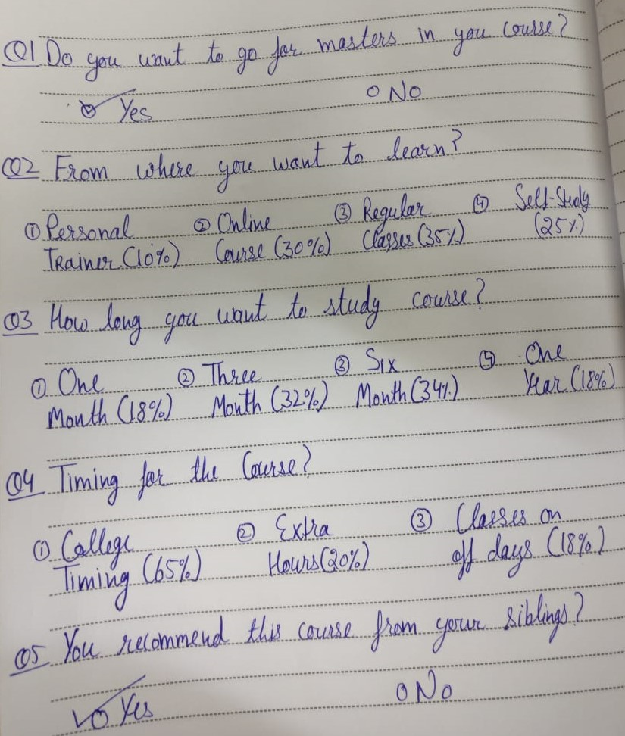
FIELD SURVEY

Slide 18
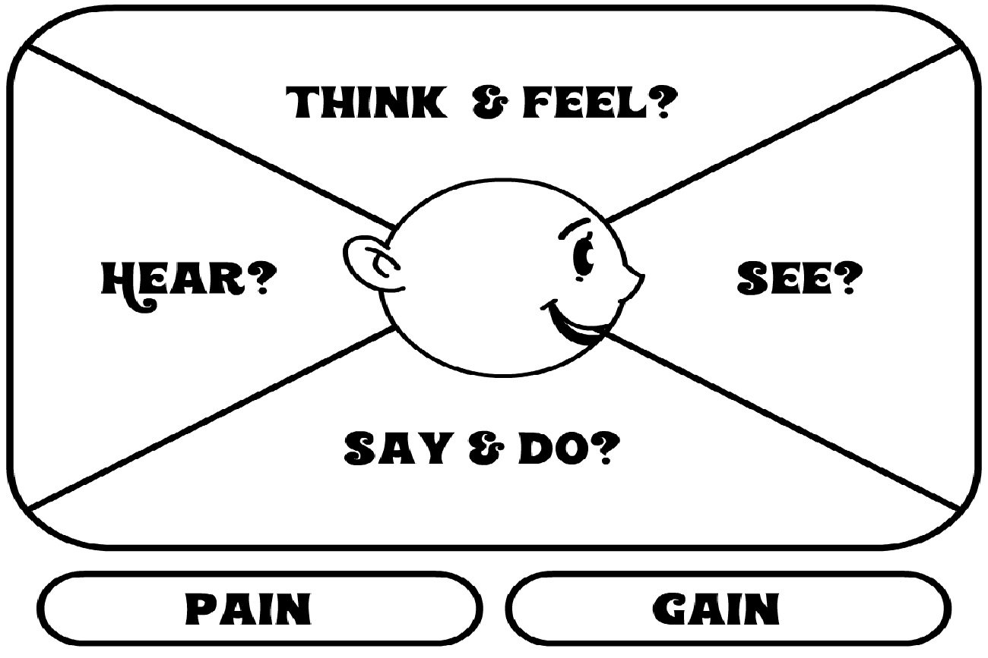
EMPATHY MAP

Slide 19
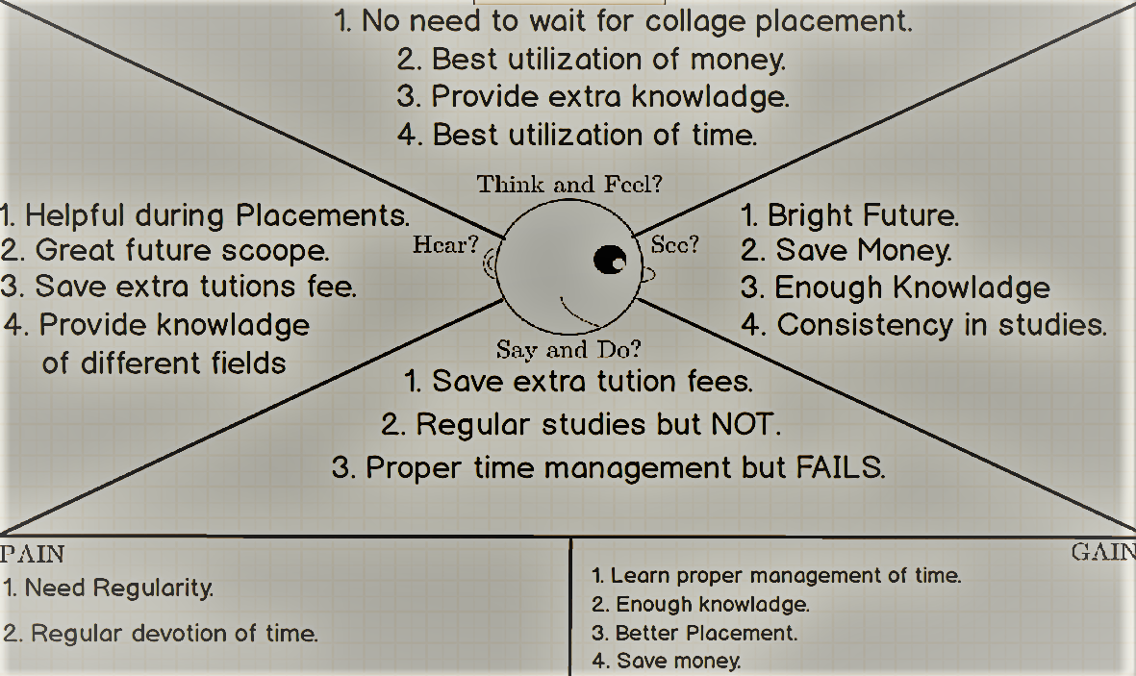
EMPATHY MAP

Slide 20
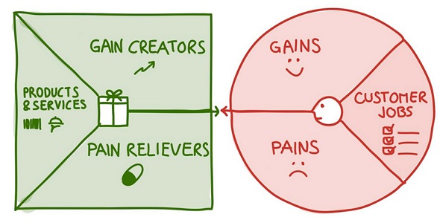
VALUE PROPOSITION CANVAS

Slide 21
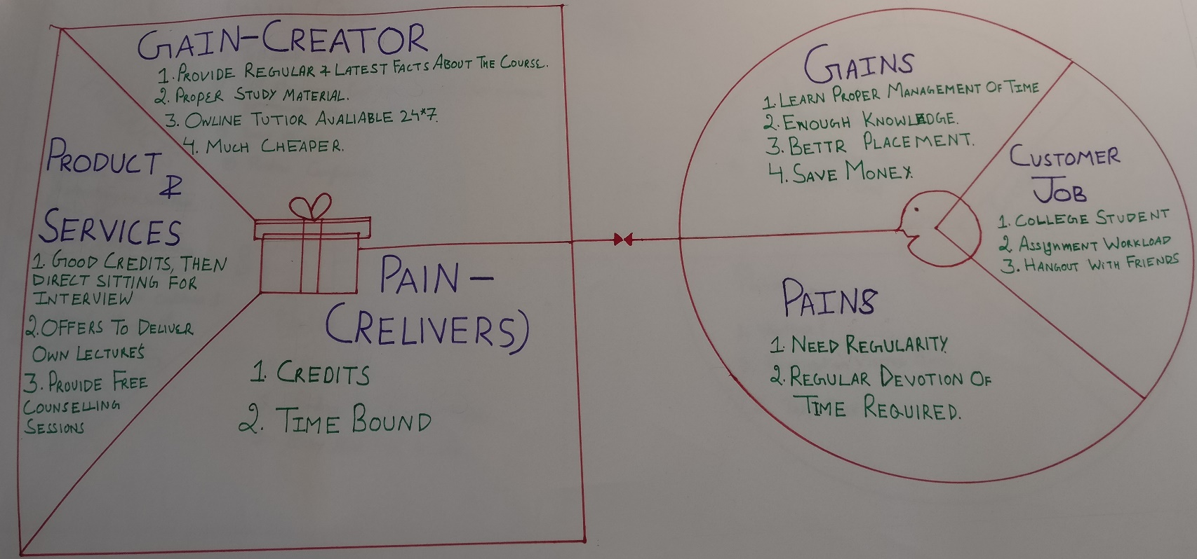
VALUE PROPOSITION CANVAS

Slide 22

CUSTOMER JOURNEY MAP

Slide 23
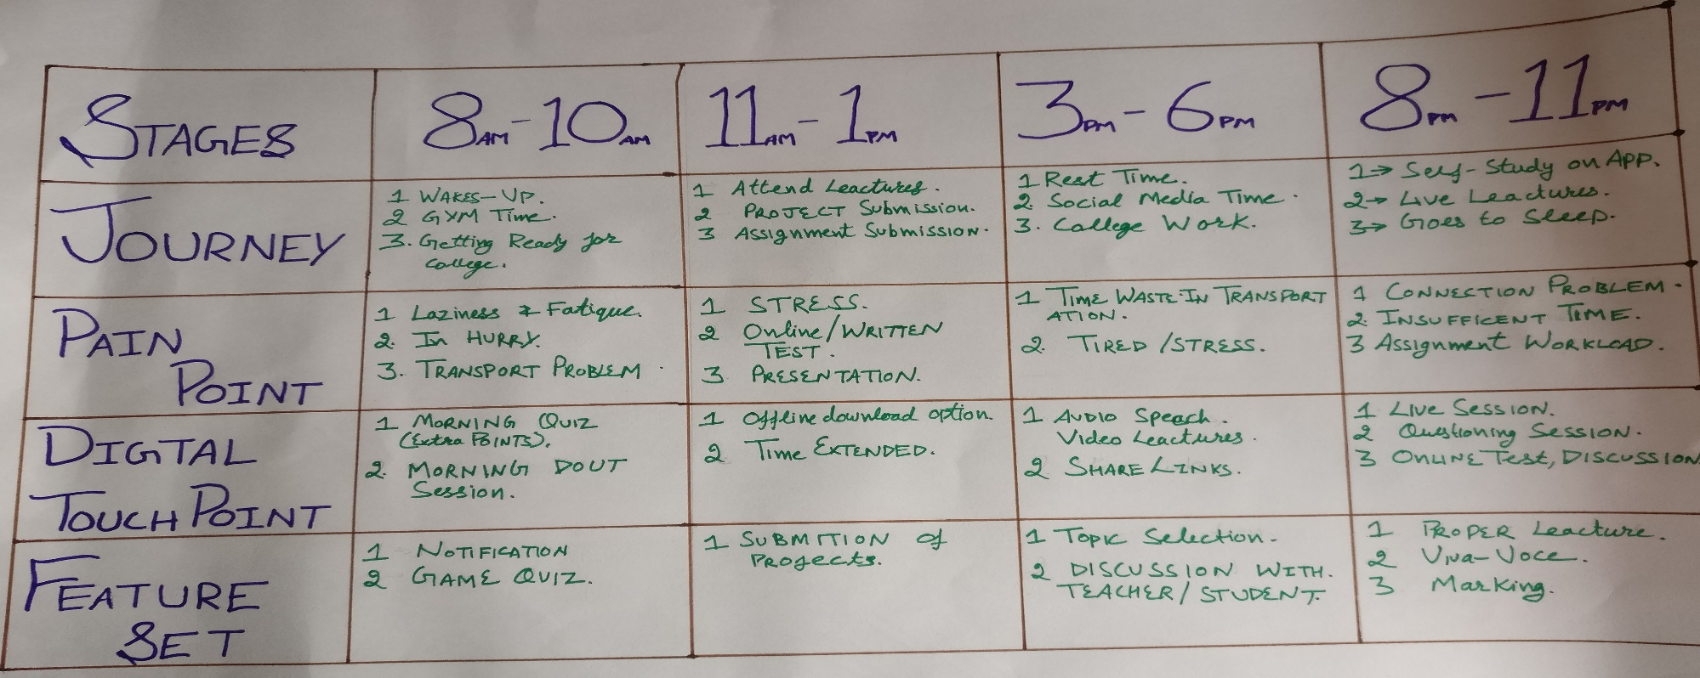
CUSTOMER JOURNEY MAP

Slide 24
USER PERSONA

Slide 25
USER PERSONA

Slide 26
STORY BOARDING

Slide 27
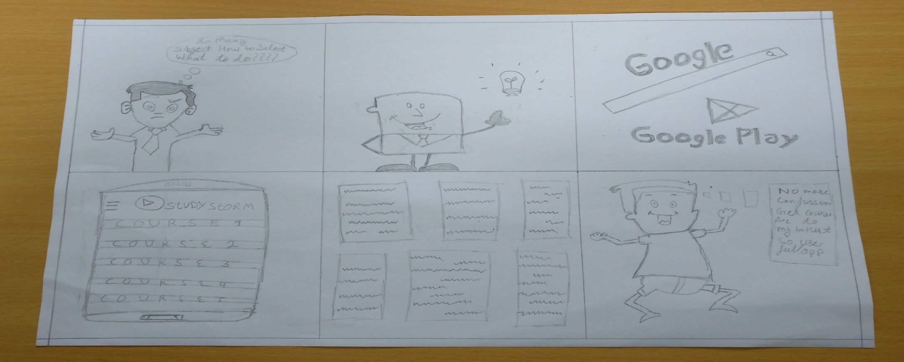
STORY BOARDING

Slide 28
SOLUTIONS WE HAVE
First thing is if we want to get out from this problem we should start devoting
some time for our self-studies. To make it easy I’m going to designing a app for
the students. This app include all the main courses which students are going to study in
their B.Tech(CSE) course.
THE SOLUTIOS ARE:-
1.My app provide detail knowledge of every course.
2. You we get live sessions, videos, audio for better understanding.
3.You will get online quiz, tests to check you progress.

Slide 29
THANKS

